Slide 1
Alcoholics Anonymous
Let’s Be Friendly with Our Friends
Notes:
Introductions
Sample C.P.C. Presentation:
These slides and notes pages are offered as an example of a presentation that could be given to professionals about what A.A. is and what it is not. Please feel free to edit and change as your local needs warrant, including changing slide format as well as inserting your own graphics.
An electronic version of this PowerPoint presentation can be obtained – contact the C.P.C. Coordinator at cpc@aa.org.

Slide 2
OUTLINE
Alcoholism
What is A.A. and it’s history?
How does A.A. work
What does A.A. do?
What does A.A. NOT do?
Singleness of purpose and problems other than alcohol
Professionals and 2014 A.A. membership survey
How medical professionals can help alcoholics?
A.A. peer support in hospitals

Slide 3
The Alcoholic’s resistance to help can be frustrating
The biggest obstacle to the Alcoholics chance to get well is their inability to admit they have a problem
Rationalization and denial are symptoms of the alcoholics illness
Most alcoholics will resist any suggestion that alcoholism is involved
Often the Alcoholic will not be willing to try A.A.
A.A. members are particularly suited to help others break through denial
THERE IS HOPE
Notes:
The Alcoholic’s resistance to help can be frustrating:
Since denial of the problem is symptomatic of alcoholism, alcoholics tend to be evasive when questioned about their drinking, and some health care professionals may not recognize that alcoholism may be contributing to their symptoms. Most alcoholics will resist any suggestion that alcoholism is involved and may be equally resistant to the suggestion of Alcoholics Anonymous as a last recourse.
Few health care professionals have had the experience of having their diagnosis rejected. Few have been told, “I certainly am not a diabetic.” Yet when the health care professional makes a diagnosis of alcoholism, an alcoholic will often respond, “I don’t drink that much,” or may say, “I’m not that bad,” or will offer excuses for his or her drinking. Health care professionals can expect and anticipate this.
Rationalization and denial are part of the alcoholic’s illness. Initial rejection of A.A. is part of the denial mechanism.
A.A. members, having broken through their denial and faced the harm in their drinking, are particularly suited to helping others break through their denial.
(Pamphlet: A.A. as a resource for the medical professional)

Slide 4
What is A.A.
Notes:
What is A.A.
Alcoholics Anonymous is an international fellowship of men and women who have had a drinking problem. They share their experience, strength and hope with each other that they may solve their common problem and help others to recover from alcoholism.
The only requirement for membership is a desire to stop drinking. There are no dues or fees for A.A. membership; we are self-supporting through our own contributions. A.A. is not allied with any sect, denomination, politics, organization or institution; does not wish to engage in any controversy; neither endorses nor opposes any causes. Our primary purpose is to stay sober and help other alcoholics to achieve sobriety.

Slide 5
History of A.A.
Notes:
A.A. began in 1935. Bill W. a stock broker from New York sobered up late in 1934 and realized that his efforts to help other drunks had helped him to stay sober. On a business trip to Akron in 1935, he was put in touch with an alcoholic surgeon, Dr. Bob. When the doctor also recovered, he said to Bill "If you and I are going to stay sober, we had better get busy."
Dr. Bob called Akron's City Hospital and told the nurse that he and a man from New York had a cure for alcoholism. Did she have an alcoholic customer on whom they could try it out? She told him of a man who had just come in with DT's, he had blacked the eyes of two nurses.
The nurse told Dr. Bob and Bill that Bill D. had been a well-known attorney in Akron and a city councilman. But he had been hospitalized eight times in the last six months. Following each release, he got drunk even before he got home.
So Dr. Bob and Bill talked to what may have been their first "man on the bed." They told him of the serious nature of his disease, but also offered hope for a recovery. "We told him what we had done," wrote Bill, "how we got honest with ourselves as never before, how we had talked our problems out with each other in confidence, how we tried to make amends for harm done others, how we had then been miraculously released from the desire to drink as soon as we had humbly asked God, as we understood him, for guidance and protection.“ Bill D, the man on the bed, stayed sober from that visit up until his death.
The movement spread and acquired its name with the publication of the book Alcoholics Anonymous in 1939. A.A. now has more than two million members in more than 180 countries. While A.A. keeps no membership records, we estimate that world-wide there are over 117,000 groups, and approximately 2 million members. (2015 data)

Slide 6
How Does A.A. Work
A way to stop drinking and stay stopped
A.A.’s suggested Twelve Steps are the program of recovery
The Steps are based on the experience of early A.A. members
A.A. is spiritual, not religious
Notes:
How Does AA Work?
Chiefly through local meetings, where alcoholics help one another to use the A.A. program of recovery (12-steps)
The Twelve Steps are the basis of the program of recovery and contain suggested principles that outline the actions of our early members’ experience with overcoming their alcoholism. Once someone stops drinking, he or she attends meetings and practices the Twelve Steps to stay stopped. A.A. is not allied with any sect, denomination, politics, organization or institution. A.A. groups affiliating with no one and cooperate with all.
There are no new ideas, but rather a collection of broad spiritual principles and actions, including admission of the alcohol problem, acceptance of help from others, self-inventory, restitution for harms done, and service to others, especially to other alcoholics.
A.A. is not affiliated with any specific religion, but cooperates with the clergy of all faiths.
A.A. has members who are atheist, agnostic, Christian, Buddhist, Muslim, Jewish, etc.

Slide 7
What Does A.A. Do?
Offers a Twelve Step program of recovery
Groups put on A.A. meetings
A.A. members share their experience
Local committees carry the A.A. message
Notes:
What Does AA Do?
A.A. members share their experience with anyone seeking help with a drinking problem; they give person-to-person service or “sponsorship” to the alcoholic coming to A.A. from any source. The A.A. program, set forth in our Twelve Steps, offers the alcoholic a way to develop a satisfying life without alcohol.
The A.A. program of recovery offers the alcoholic a way to stop drinking alcohol, and stay stopped.
Recovery is discussed at A.A. groups and meetings.
A.A. members share their experience with anyone seeking help with a drinking problem.
They give person-to-person attention to the alcoholic coming to A.A. This is ongoing, informal and unpaid.
Local A.A. committees bring the A.A. message to alcoholics, upon request, as well as to professionals who encounter alcoholics in the course of their work.

Slide 8
What Does A.A. Not Do?
Furnish initial motivation for alcoholics to recover
Solicit members or keep attendance records/case histories
Make medical diagnoses
Offer religious services
Accept any money or services, or any contributions from non-AA sources
Notes:
What A.A. does NOT do:
A.A. does not:
Furnish initial motivation for alcoholics to recover.
Solicit members.
Engage in or sponsor research.
Keep attendance records or case histories.
Join “councils” of social agencies (although A.A. members, groups and service offices frequently cooperate with them). 6. Follow up or try to control its members.
Make medical or psychological diagnoses or prognoses.
Provide detox or nursing services, hospitalization, drugs, or any medical or psychiatric treatment.
Offer religious services or host/sponsor retreats.
Engage in education about alcohol.
Provide housing, food, clothing, jobs, money, or any other welfare or social services
Provide domestic or vocational counseling.
Accept any money for its services, or any contributions from non-A.A. sources.
Provide letters of reference to parole boards, lawyers, court officials, social agencies, employers, etc.

Slide 9
Singleness of Purpose
A.A.‘s focus is on recovery from alcoholism
Anyone may observe open meetings
Closed meetings are for those with a drinking problem
People with problems other than alcoholism are able to become A.A. members if they also have a drinking problem
A.A. members bring meetings into correctional and treatment facilities
Notes:
Singleness of Purpose
A.A. offers help to alcoholics, and the focus of A.A. meetings is recovery from alcoholism.
Anyone may observe A.A. meetings designated as open to see how A.A. works.
Only those with a drinking problem may attend closed meetings or become A.A. members.
People with problems other than alcoholism are able to become A.A. members only if they also have a drinking problem.
The A.A. Fellowship makes its message freely available. What the alcoholic does with it is up to him or her.
A.A. meetings are often brought into correctional and treatment facilities, upon request.

Slide 10
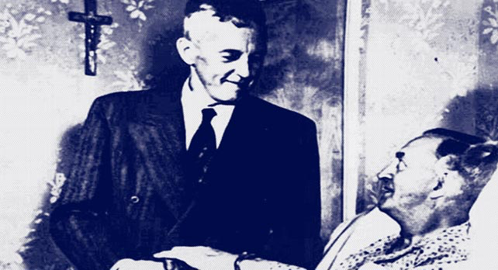
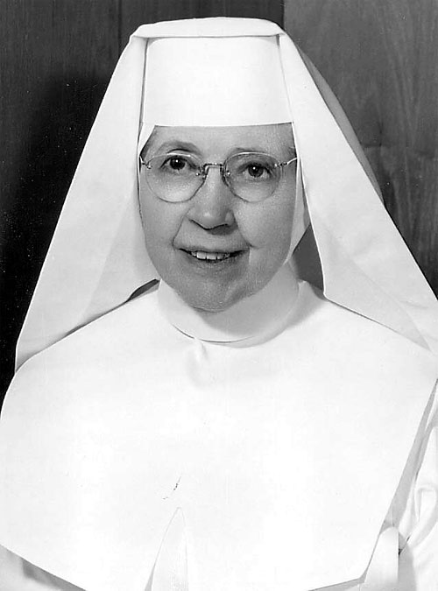
A.A.’s Spirit of Service
Notes:
A.A. members help other alcoholics in the spirit of service. From the basic text of Alcoholics Anonymous: “Practical experience shows that nothing will so much insure immunity from drinking as intensive work with other alcoholics. It works when other activities fail…”
Bill W. – visiting a patient in hospital bed.
Sister Ignatia - She also worked with Dr. Bob at st. Thomas hospital in Akron Ohio, treating the first 5,000 alcoholics in hospital setting for free.

Slide 11
Why knowledge about alcoholism and A.A. is important to medical professionals
According to the NCADD¹, there are 17.6 million people in the U.S. suffering from alcoholism
A.A. estimates² to have ~2 million members in the U.S. and Canada
Millions more sick alcoholics are still out there, suffering….
¹ A.A. has no affiliation with the National Council on Alcoholism and Drug Dependence, Inc. (NCADD)
² A.A. does not keep membership records. The information shown here is based on reports given by groups and does not represent an actual count of those who consider themselves A.A. members.

Slide 12
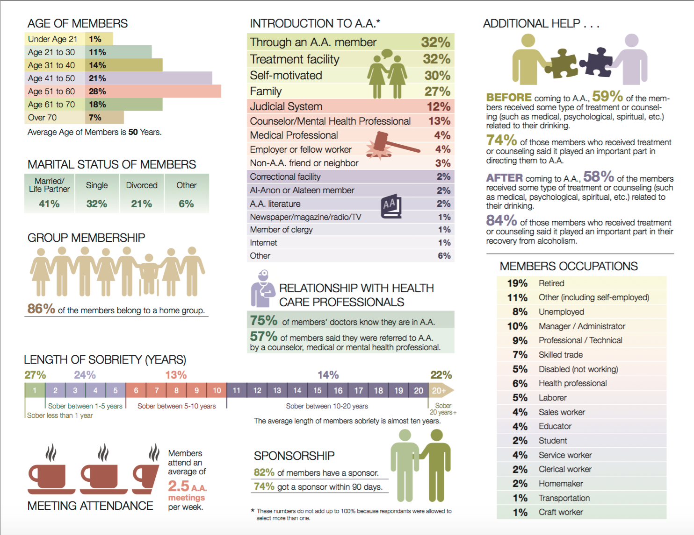
Notes:
74% of members who received some type of treatment or counseling related to their drinking said it played an important part in directing them to A.A.
57% of member said they were referred to A.A. by a counselor, medical or mental health professional

Slide 13
How medical professionals can help?
Be honest and empathetic with the alcoholic patient
Make it clear that she has a progressive and often fatal illness, and that she can’t get well by herself, and she needs a lot of help
At this stage, the main objective is that the alcoholic recognize that they have a problem. When the alcoholic accepts that they have a problem, the battle is half won
Provide information about A.A. to the alcoholic patient
¹ From the A.A. 2014 Membership Survey
Notes:
How do A.A. members and professionals interact:
A referral from a professional may provide the motivation an individual needs to seek help.
A.A. members provide a support network, meetings and practical experience for those who want to stop drinking and stay sober.
A.A. members are available in your community to offer help to your alcoholic clients or patients.
Informational meetings or presentations can also be arranged for any professionals who have an interest in learning more about what A.A. is and what it is not.

Slide 14
A.A. Peer Support in Hospitals
Peer Support: A.A. volunteers visit the patient in the hospital at their bedside
Bridge: A.A. volunteers take patients to meetings upon discharge
Training: A.A. volunteers provide information about A.A. to Hospital professionals

Slide 15
Peer Support Visit Process
After a patient has been identified with an Alcohol Use Disorder(AUD), the patient is asked if they would like a peer support visit from members of Alcoholics Anonymous.
If patients agrees, they sign an ROI
Hospital staff emails A.A. with patient: name, sex, location, phone number.
Within 3-4 hours, 2 A.A. volunteers (same sex as patient) arrive to hospital and check in with the nurse station before entering the patients room.
The visit with the patient is confidential and like a very small meeting of Alcoholics Anonymous. If the patient is interested in additional help from A.A., a bridge is offered.

Slide 16
Hospital Process
Email to A.A.
Email: [hospital specific email address]
Subject: “A.A. Peer Visit”
Content: Patient Name, Sex, Location, Phone Number for patient after release or meeting place if homeless
A.A. volunteers try to arrive within 4 hours of receiving the email request.
QUESTION
NO
Offer A.A. literature
Would patient like a peer support visit from A.A.?
YES
Will patient be discharged within 4 hours?
NO
Patient signs ROI form, staff sends email to A.A., Volunteers arrive
When?
YES
Can patient wait?
NO
Offer A.A. literature
Ask during triage/early in ED visit as soon as the role of alcohol is apparent.
YES
Patient Signs ROI form, staff emails A.A., Volunteer arrive
Notes:
For ED patients getting released prior to A.A. visit, be sure to ask patient for a phone number where they can be reached after they are discharged. This way, AA Volunteers can reach patient after they were discharged.

Slide 17
Bridge
A Bridge is when A.A. volunteers help a patient get to A.A. meetings upon their discharge from the hospital. Prior to the patient being discharged from the hospital, the Bridge is arranged by the A.A. volunteers who met the patient at hospital and A.A. members in the local community to where the patient lives.

Slide 18
Hospital Professionals
Professionals meet alcoholic patients in recovery.
Social workers, doctors, nurses, councilors, ER teams, residents, medical students, patient coordinators, and more.
Meetings are typically one hour with two to three A.A. members sharing what A.A. is and how it works and how their recovery from alcoholism was helped by medical professionals.
We also explain the peer support program process and answer questions.
The main objective of these training sessions is to help medical staff feel more comfortable talking to patients about their drinking and to recommend an A.A. peer support visit during their hospitalization.
Notes:
We are available to meet with any hospital professionals interested in learning more about Alcoholics Anonymous and how A.A. might help their patients with a drinking problem. We meet with social workers, doctors, nurses, councilors, ER teams, residents, medical students, patient coordinators, and more. Meetings are typically one hour with two to three A.A. members sharing what A.A. is and how it works and how their recovery from alcoholism was helped by medical professionals. We also explain the peer support program process and answer questions. We receive highly positive feedback from staff that attend these meetings. Meeting alcoholics in recovery seems to boost the morale of care takers working with such a difficult demographic of patients. The main objective of these training sessions is to help medical staff feel more comfortable talking to patients about their drinking and to recommend an A.A. peer support visit during their hospitalization.

Slide 19
Hospitals Currently in Cooperation with A.A. in Western Washington
Virginia Mason -Seattle
Overlake - Bellevue
Peace Health - Kelso/Longview
CHI Franciscan Network – Western Washington
MultiCare Network – Western Washington
Swedish Network - Seattle

Slide 20
Get more information about A.A.
Maintain contact with the local A.A. community
Attend an open A.A. meeting
Read A.A. literature directed to professionals
Subscribe to the About A.A. newsletter for professionals: http://www.aa.org/pages/en_US/subscribe-to-about-aa-newsletter-for-professionals
Notes:
Here are some suggestions on how professionals can get more information about A.A.:
Maintain a contact with the local A.A. community.
Contact a local central office or intergroup for open A.A. meeting information.
Observe open A.A. meetings yourself.
Talk to people in A.A. about their A.A. experiences and learn from them about recovery.
Read A.A. literature – the Big Book, Twelve Steps and Twelve Traditions, and numerous pamphlets.
Subscribe to the free About A.A. newsletter for professionals
Subscribe to The AA Grapevine monthly magazine or the Spanish language La Viña magazine (subscription fee).
Contact the General Service Office in New York to get in contact with A.A. in your community.

Slide 21
Alcoholics Anonymous
Thank You!
www.aa.org

